Slide 1
Data Management Presentation
Aila Enos, Raj Bose, Emily Hart

Slide 2
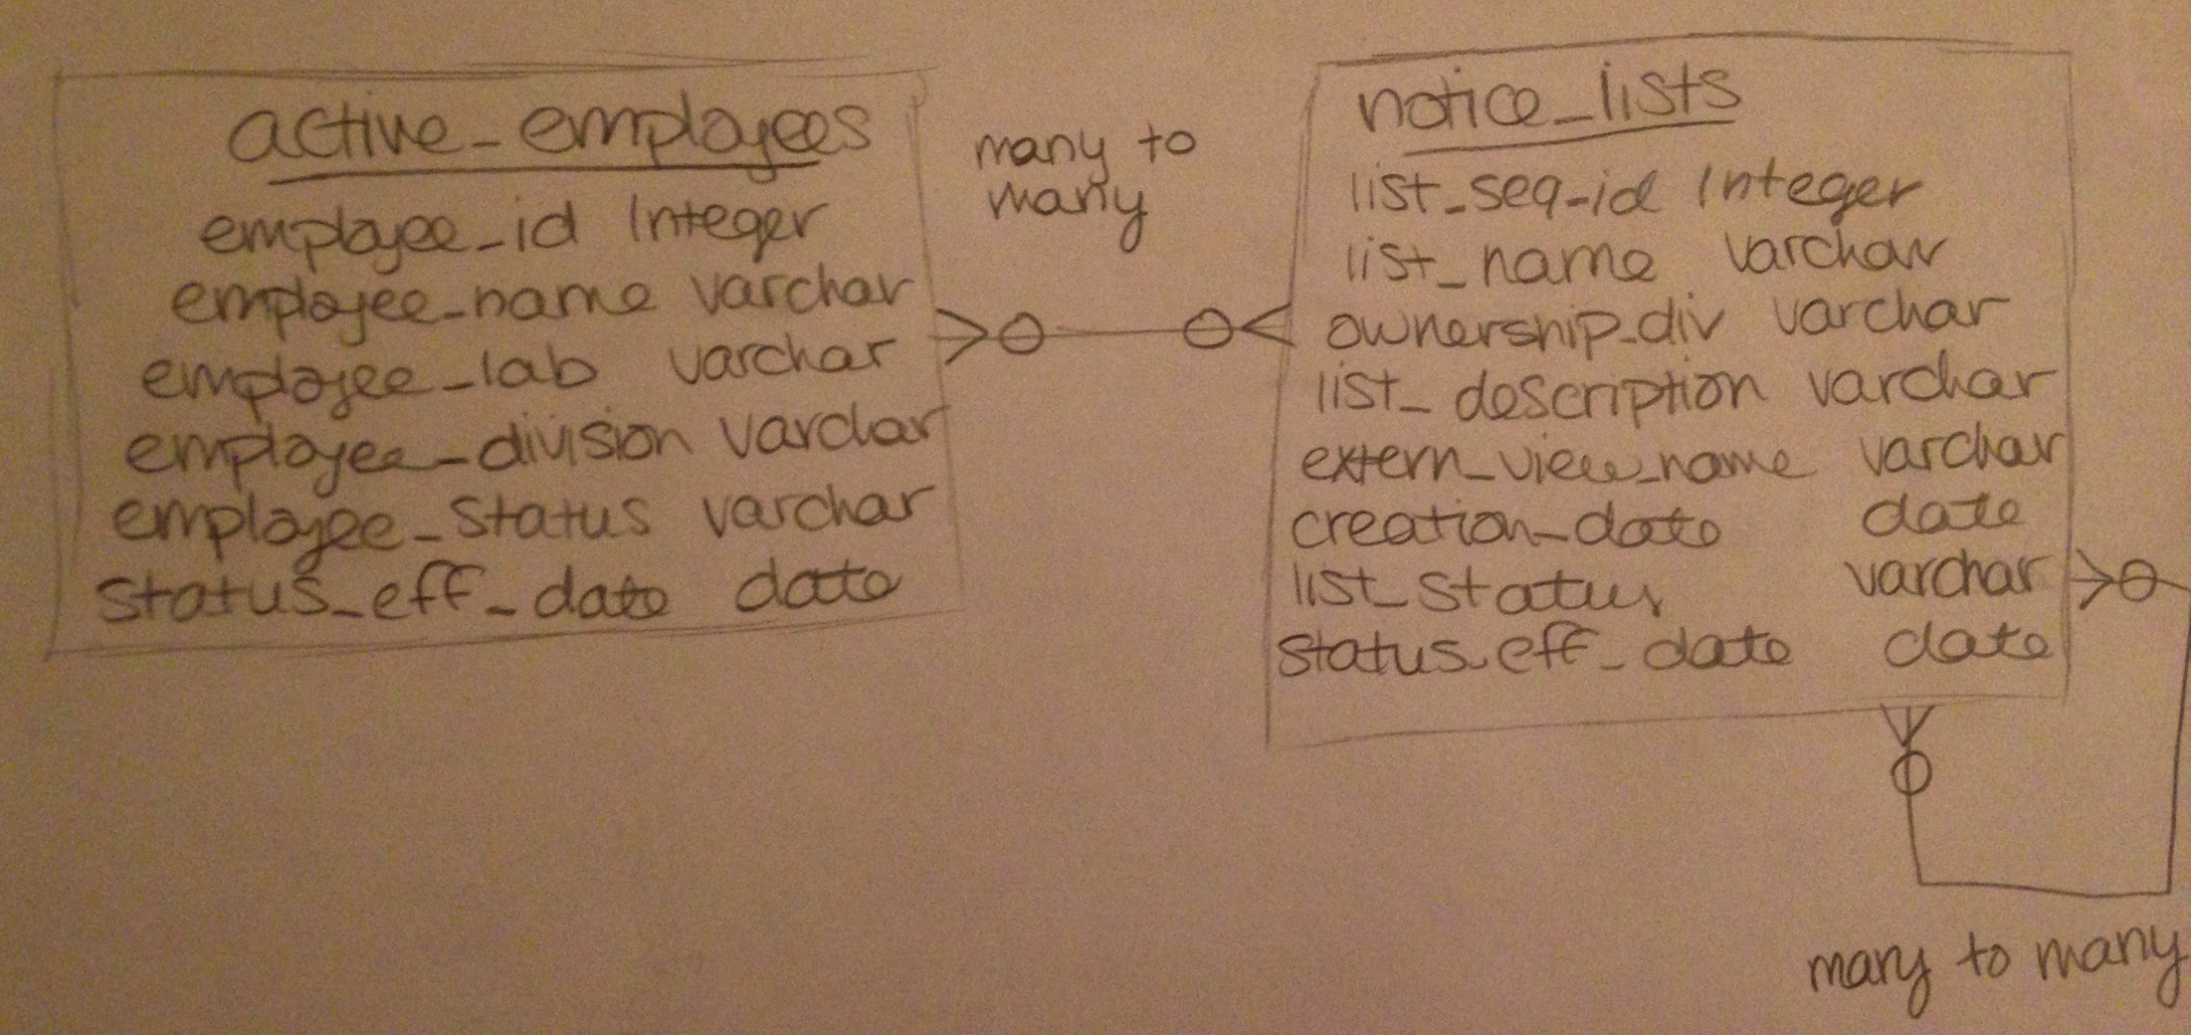
Conceptual Model

Slide 3
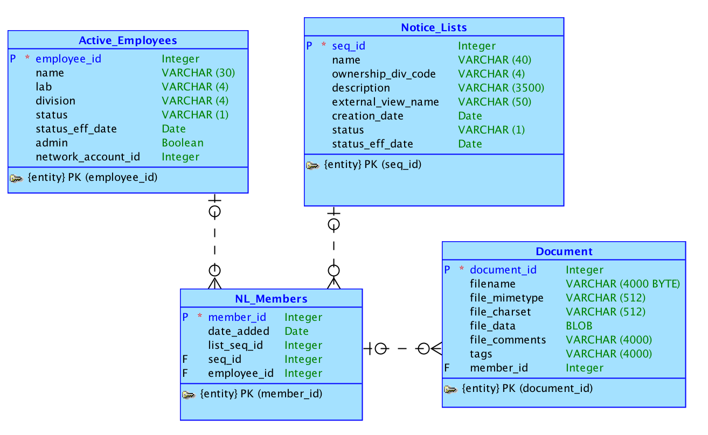
Logical Model

Slide 4
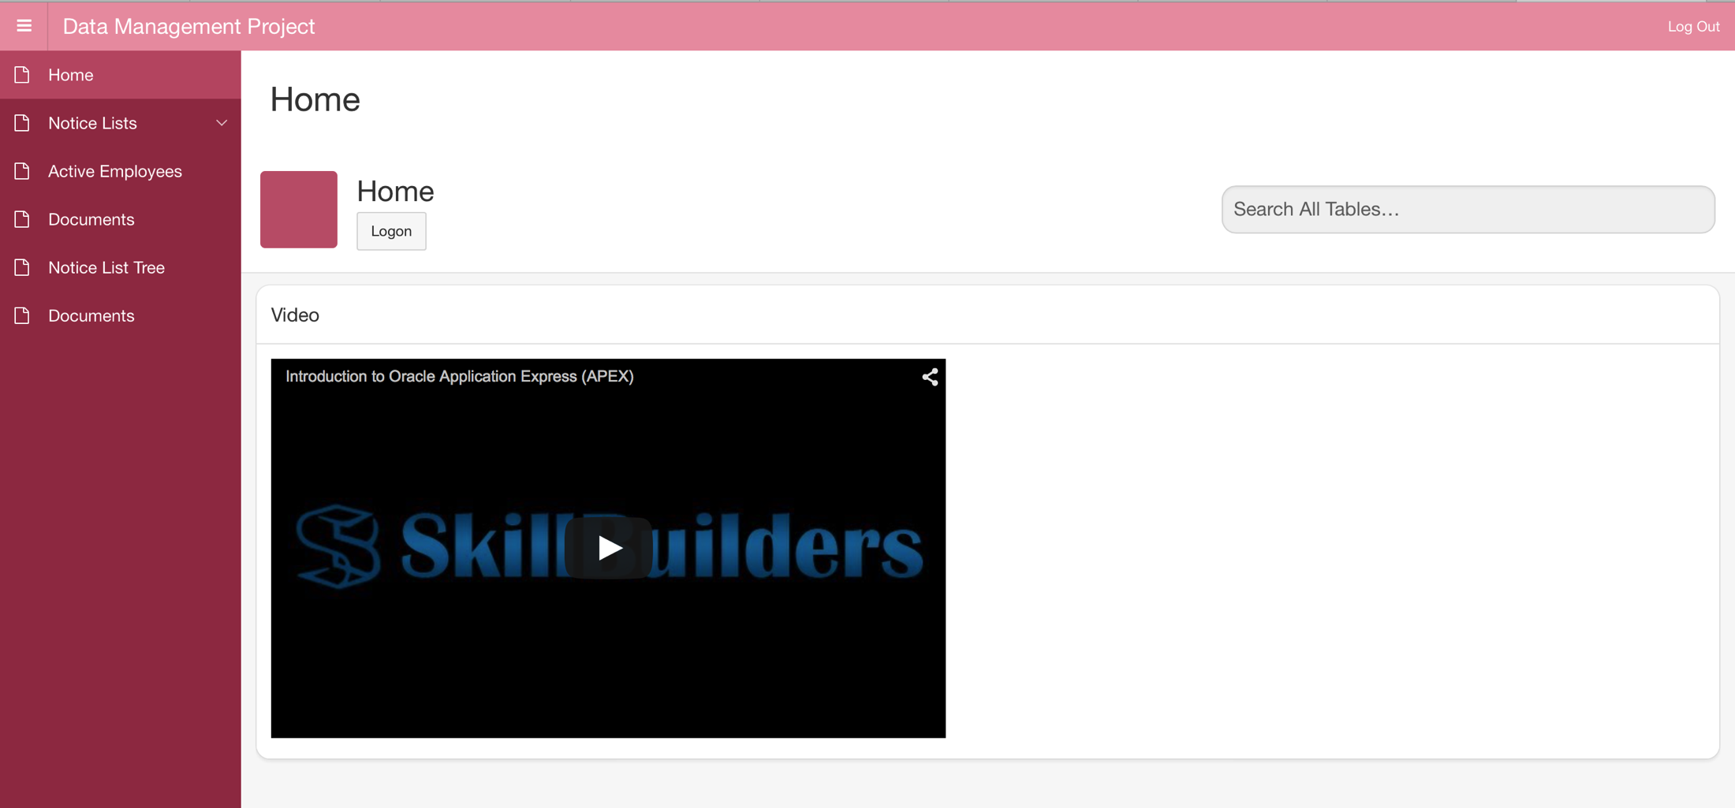
Home

Slide 5
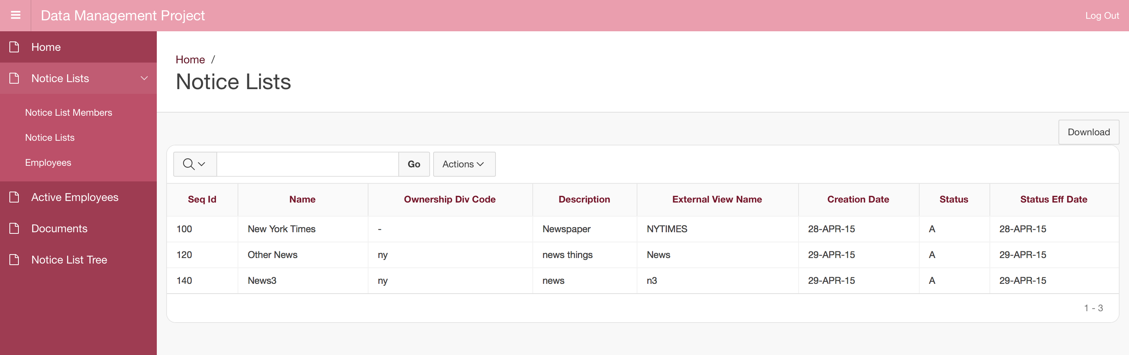
Notice Lists

Slide 6
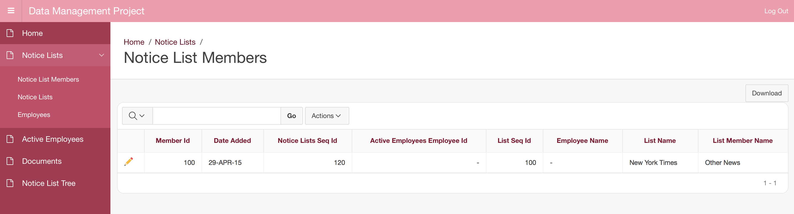
Notice List Members

Slide 7
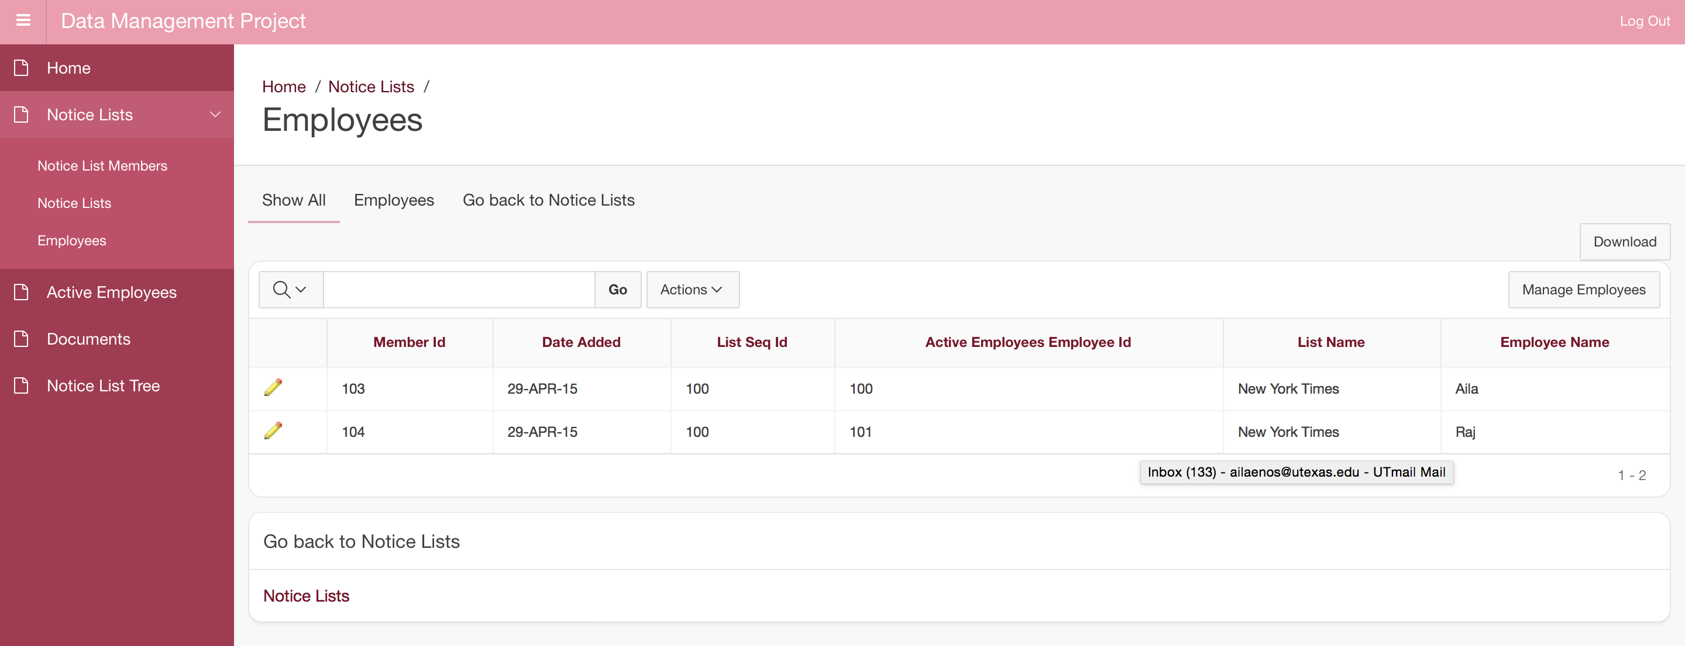
NL Members – Employees

Slide 8
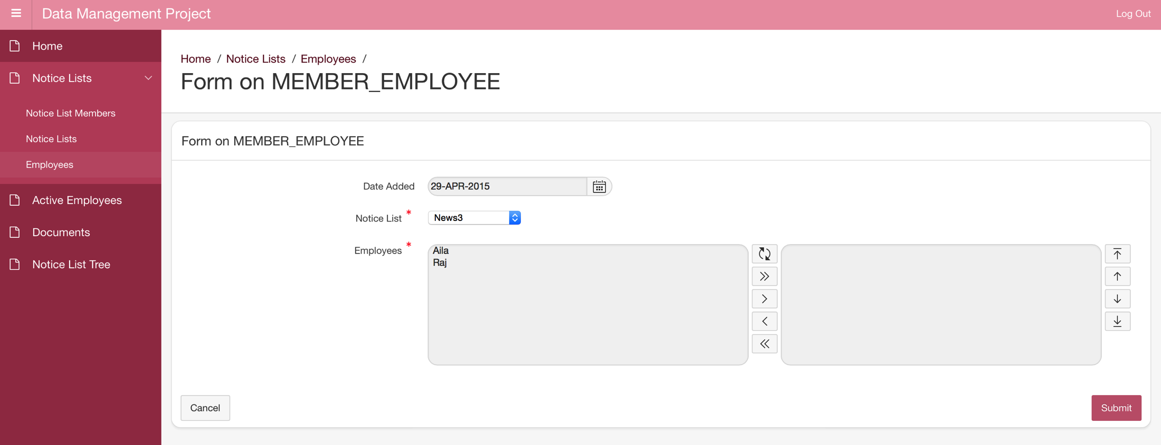
Adding Employees to a Notice List

Slide 9
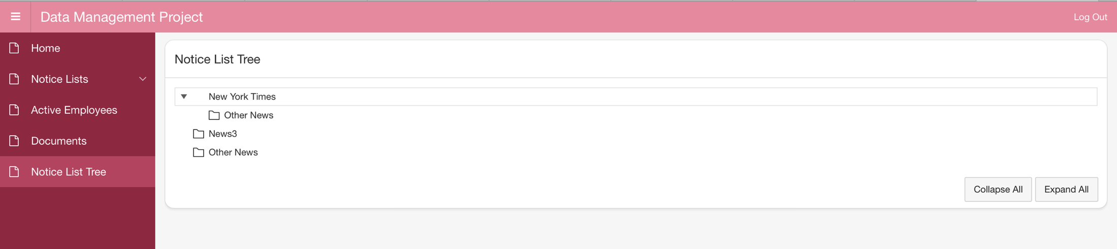
Tree

Slide 10
Apex URL
Apex URL

